Slide 1
CHAPTER 12
Experiments with More than One Independent Variable

Slide 2
Chapter Outline
Review: Experiments with one independent variable
Experiments with two independent variables can show interactions
Factorial variations
Identifying factorial designs in your readings
Notes:
These are the major headings in this chapter.

Slide 3
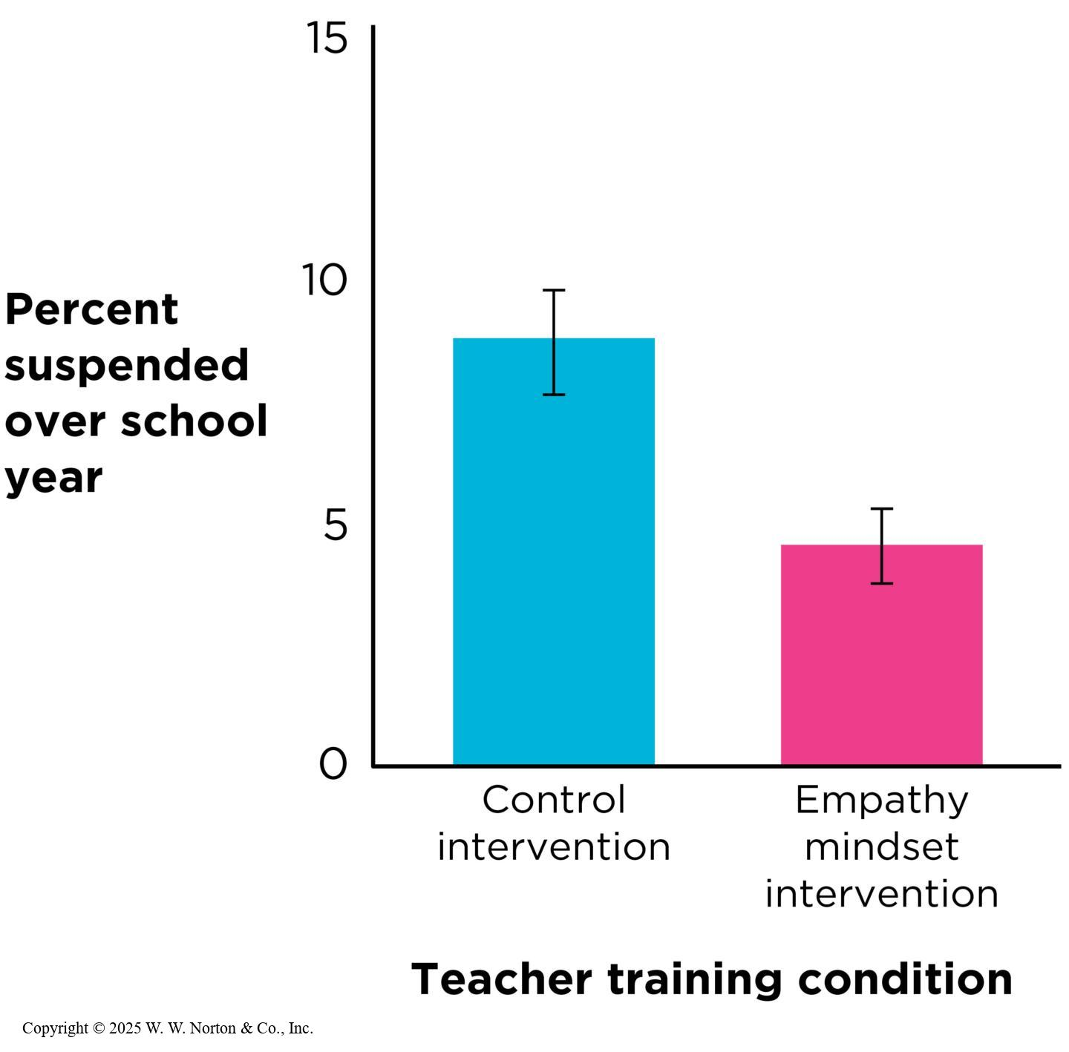
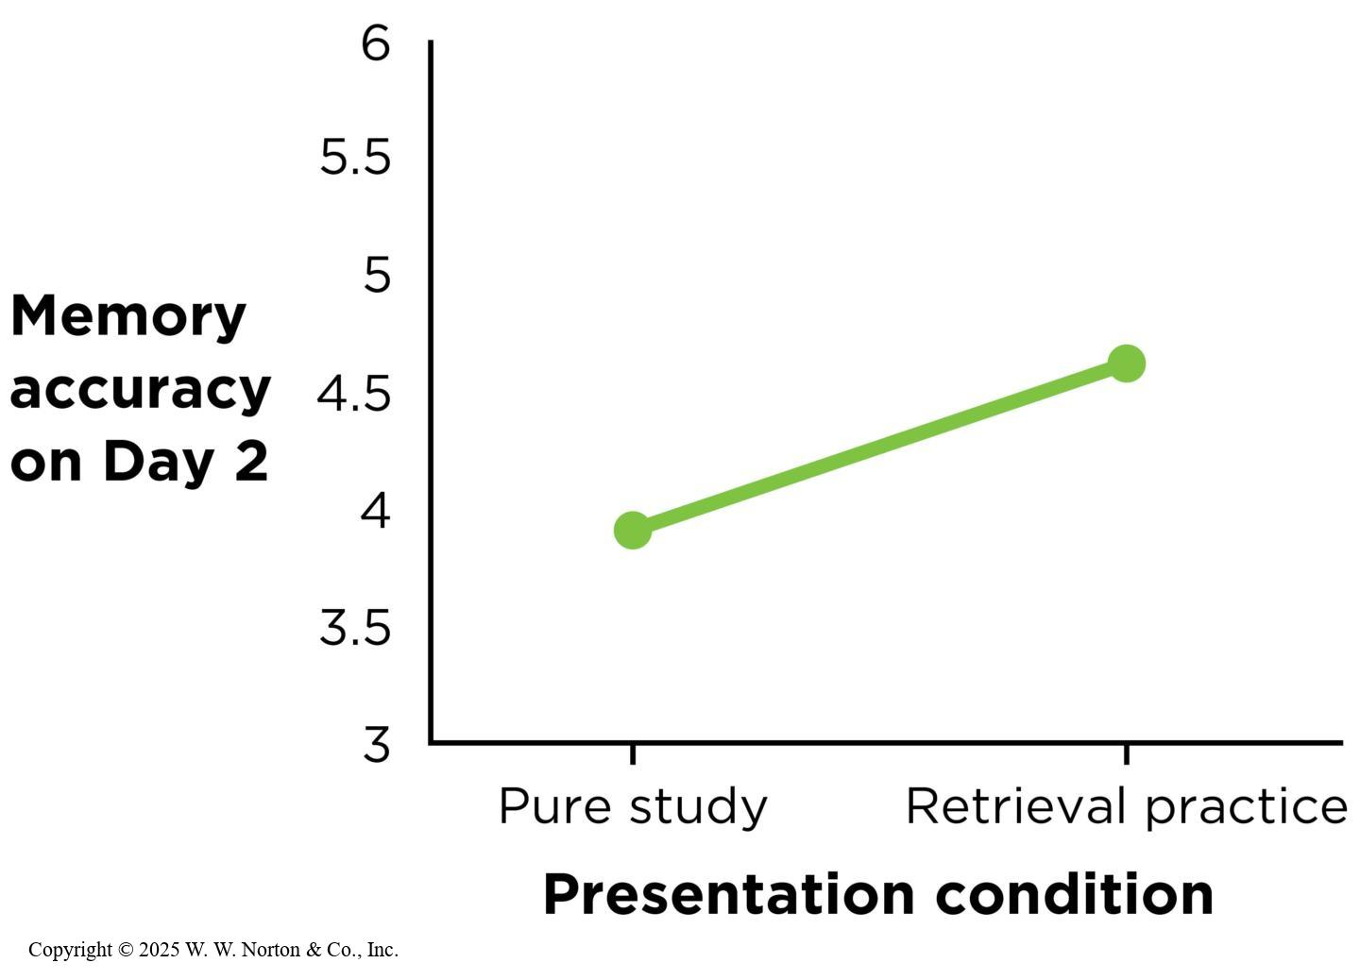
Review: Experiments with One Independent Variable
Notes:
Figure 12.1: An Empathy Mindset
When teachers participated in the empathy mindset intervention, their students had half the rate of disciplinary suspensions over the subsequent year, compared with a control group of teachers who learned about classroom technology. Error bars represent 95% CIs. (Source: Adapted from Okonofua et al., 2016, Study 3.)
Copyright © 2025 W. W. Norton & Co., Inc.
Figure 12.2: Comparing Pure Studying to Retrieval Practice for Word Pairs
In this study, students either read complete pairs of Yupik vocabulary words for 10 seconds each (pure study), or they were shown only the Yupik word for 5 seconds, followed by the word and its English translation for 5 seconds (retrieval practice). Error bars are omitted because the relevant information was not available in the original article. (Source: Adapted from Carrier & Pashler, 1992.)
Are empathetic teachers more effective? Take a look at the two graphs from a study reported by Science Daily (2022) examining the effects of teacher empathy on student outcomes. In the study, teachers were trained in empathy-building techniques designed to foster better relationships with their students. Students taught by empathetic teachers showed significantly improved engagement and academic performance. The top graph on the left shows that students in the empathy-trained group demonstrated higher engagement levels compared to the control group, while the bottom graph on the left indicates that students in the empathy-trained group also achieved better test scores.
The second study involves the benefits of retrieval practice on learning. Education Corner (2022) explored how regularly recalling information impacts long-term retention. Participants were divided into two groups: one group engaged in retrieval practice (e.g., quizzes or self-testing), while the other group engaged in repeated review of the material. As shown in the graph on the right, the retrieval practice group demonstrated significantly higher retention rates over time than the review-only group. The results highlight the effectiveness of retrieval practice in strengthening memory and improving learning outcomes.
Copyright © 2025 W. W. Norton & Co., Inc.

Slide 4
Experiments with Two Independent Variables Can Show Interactions
Intuitive interactions
Factorial designs study two independent variables
Factorial designs can test limits
Factorial designs can test theories
Interpreting factorial results: main effects and interactions
Notes:
An interaction effect (also known as an interaction) occurs when the effect of one independent variable (IV) depends on the level of another IV. An interaction between two IVs allows researchers to determine whether “it depends.” Let’s reconsider the study on teacher empathy. This time, a second IV (student grade level) is added to determine whether the effect of teacher empathy depends on the grade level of the students. A mathematical way to describe an interaction between two IVs is a “difference in differences.” In other words, it’s the effect of one IV (such as empathy training versus no empathy training) on the level of the other IV (for example, the improvement in engagement might differ for elementary versus high school students).

Slide 5
Introduction to Factorial Designs
Factorial design types:
  A two-factor design has two IVs.
  A single-factor design has one IV (multiple levels to each IV)
  2 × 3 × 2 design is a three-factor design with a total of 12 conditions.
Notes:
What are levels? What’s the minimum number of levels that you need?

Slide 6
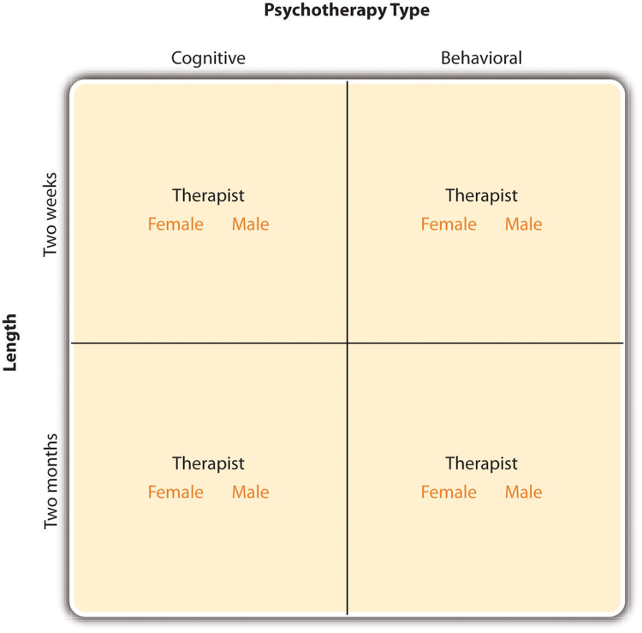
Structure of a Three Factor Experiment
Notes:
What are the factors? What are the levels?

Slide 7
Main Effects (1)
The main effect is the mean differences among the levels of one factor.
  A two-factor study has two main effects; one for each factor.
 | On Paper | On Screen
Fixed time | M = 22 | M = 18 | Overall M = 20
Self-regulated time | M = 18 | M = 14 | Overall M = 16
 | Overall M = 20 | Overall M = 16
Notes:
Table 11.2 Hypothetical Data Showing the Treatment Means for a Two-Factor Study Examining How Different Modes of Presentation and Methods of Controlling Study Time Affect Performance on a Multiple-Choice Test

Slide 8
Main Effects (2)
The main effect is the mean differences among the levels of one factor.
  A two-factor study has two main effects; one for each factor.
 | On Paper | On Screen
Fixed time | M = 22 | M = 18 | Overall M = 20
Self-regulated time | M = 18 | M = 14 | Overall M = 16
 | Overall M = 20 | Overall M = 16
Notes:
Table 11.2 Hypothetical Data Showing the Treatment Means for a Two-Factor Study Examining How Different Modes of Presentation and Methods of Controlling Study Time Affect Performance on a Multiple-Choice Test

Slide 9
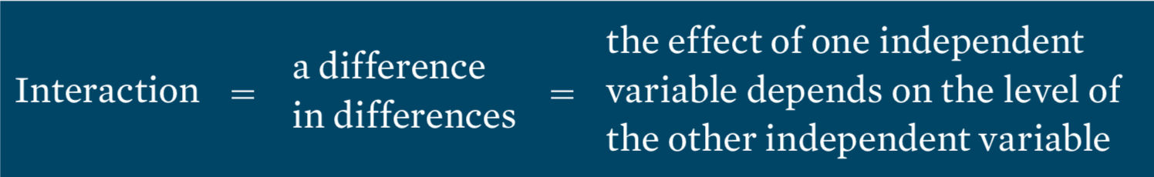
Interaction: Definition
Notes:
This set of definitions appears in the text.

Slide 10
Interaction Example
An example—drug interaction: one drug modifying the effect of another drug
  One drug can exaggerate the effects of another.
  One drug may minimize or completely block the effects of another.
Independent factors have no interaction.

Slide 11
Interaction Between Factors (1)
 | On Paper | On Screen
Fixed time | M = 20 | M = 20 | M Fixed Time = 20
Self-regulated time | M = 20 | M = 12 | M Self-Regulated = 16
 | M Paper = 20 | M Screen = 16
Notes:
What conclusions can we draw looking at the overall means?

Slide 12
Interaction Between Factors (2)
 | On Paper | On Screen
Fixed time | M = 20 | M = 20 | M Fixed Time = 20
Self-regulated time | M = 20 | M = 12 | M Self-Regulated = 16
 | M Paper = 20 | M Screen = 16
Notes:
What conclusions can we draw looking at the overall means?

Slide 13
Alternative Views of the Interaction Between Factors
Alternative definitions of interaction:
  When the effects of one factor depend on the different levels of a second factor
A second alternative definition of an interaction focuses on the pattern that is produced when the means from a two- factor study are presented in a graph.

Slide 14
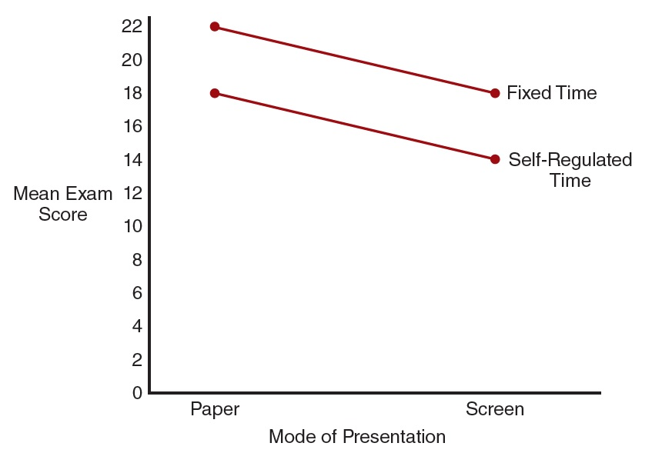
A Line Graph Indicating No Interaction
Notes:
Figure 11.2 A Line Graph of the Data from Table 11.2

Slide 15
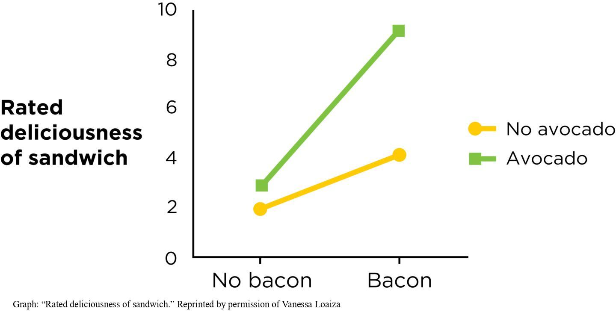
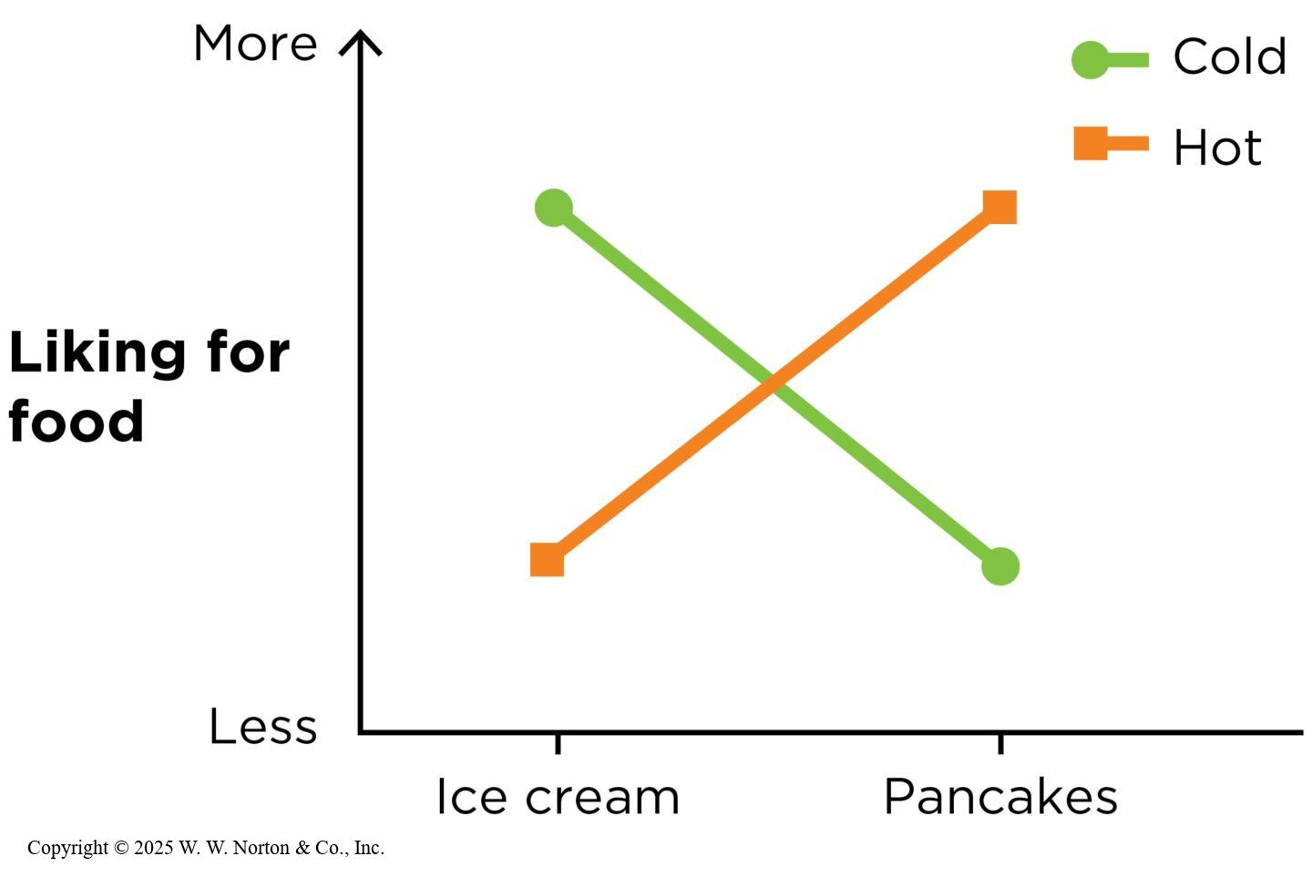
Intuitive Interactions
Notes:
Figure 12.3: A Crossover Interaction: “It Depends.”
How much you like certain foods depends on the temperature at which they are served. It’s equally correct to say that the temperature you prefer depends on which food you’re eating.
Copyright © 2025 W. W. Norton & Co., Inc.
Figure 12.4: A Spreading Interaction: “Especially When . . . .”
Sandwiches are more delicious when you add either bacon alone or avocado alone, but when they have both avocado and bacon, they taste especially wonderful. (Source: Vanessa Loaiza.)
Graph: “Rated deliciousness of sandwich.” Reprinted by permission of Vanessa Loaiza

Slide 16
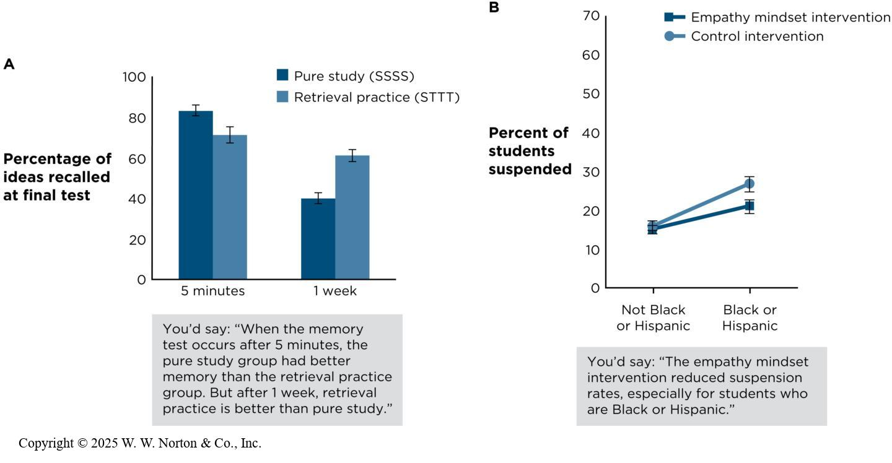
Interactions: Is There a Difference in Differences?
Describing interactions in words
Notes:
Figure 12.18: Describing Interactions in Words
(A) Method 1: Start with the first level of the independent variable (IV) on the x-axis and describe what’s happening with the other IV. Then move to the second level of the IV on the y-axis and describe what’s happening with the other IV. (B) Method 2: Describe the difference in differences, using phrases like “especially for,” “only for,” and “depends on.” Error bars indicate the standard error of each mean.
When describing an interaction in words, you should start with one level of IV₁ and explain what is happening with IV₂ at that level. Then move to the next level of IV₁ and do that same thing. This approach is depicted in the graph and description on the left. Another approach is to use such phrases as “especially for” and “depends on,” as depicted on the right.
Copyright © 2025 W. W. Norton & Co., Inc.

Slide 17
Independence of Main Effects and Interactions
The two-factor study allows researchers to evaluate three separate sets of mean differences:
  The mean differences from the main effect of factor A
  The mean differences from the main effect of factor B
  The mean differences from the interaction between factors

Slide 18
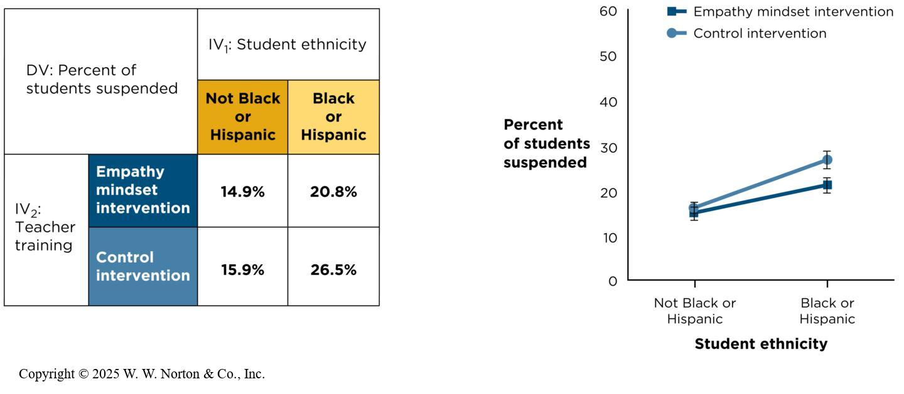
Factorial Designs Can Test Limits (1 of 2)
Notes:
Figure 12.7: Factorial Design Results in Table and Graph Formats
The error bars indicate the estimated standard errors of each mean. (DV = dependent variable; IV = independent variable.) (Source: Adapted from Okonofua et al., 2022.)
Sometimes, researchers conduct factorial designs to test whether an IV affects different kinds of people or people in different situations in the same way. This figure shows the results from the teacher empathy and student grade level study in a table form and in a graph form.
You will notice that in the line graph, the two lines are parallel, which indicates that the effect of empathy training did not depend on grade level. In other words, there was no interaction between empathy training and grade level. You can see that high school students overall showed slightly higher engagement levels than elementary students, and participants overall performed better when taught by empathy-trained teachers than by teachers without such training.
Copyright © 2025 W. W. Norton & Co., Inc.

Slide 19
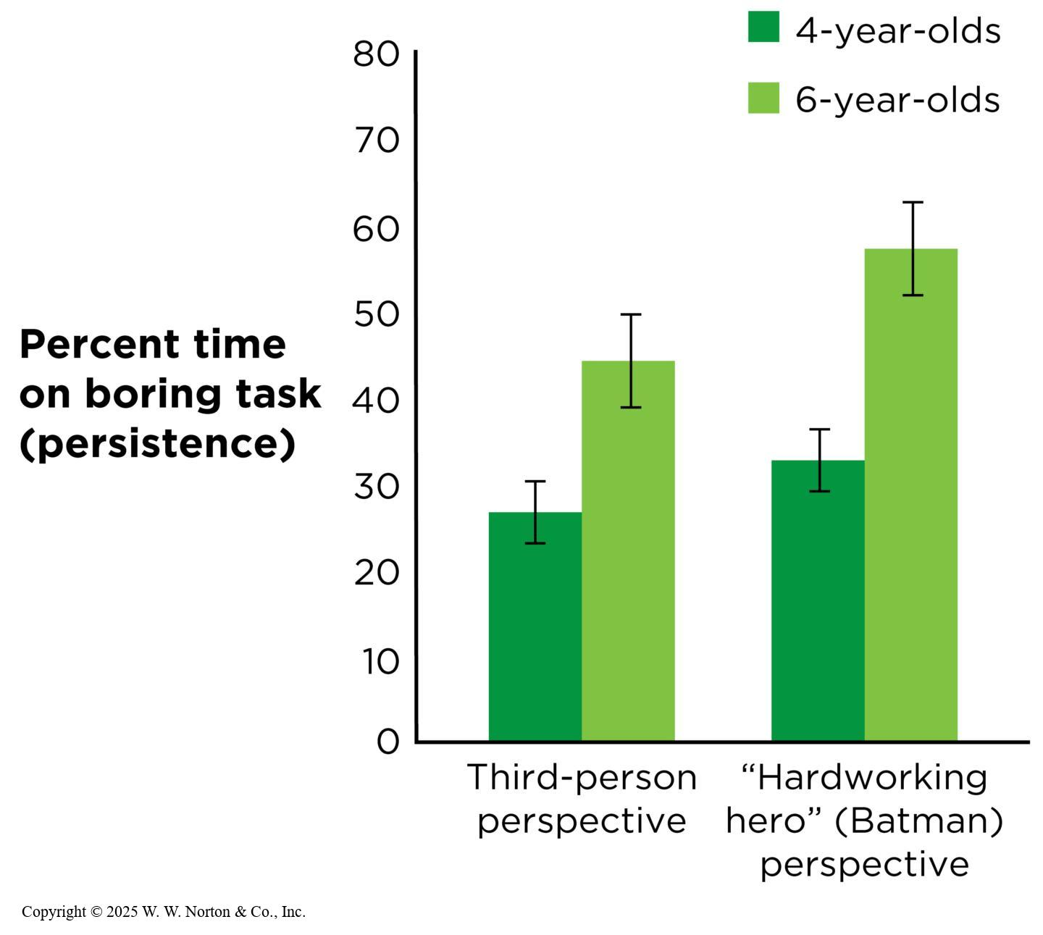
Factorial Designs Can Test Limits (2 of 2)
A form of external validity
Interactions show moderators
Notes:
Figure 12.8: Testing Limits with Factorial Design
According to this study, the “Batman” instructions worked about the same in both 4-year-olds and 6-year-olds. Error bars indicate the standard error of each mean. (Source: Adapted from White et al., 2017.)
Testing limits relates to external validity. Remember the “Batman effect” study? What if researchers wondered if the effect of adopting an alter ego to increase perseverance depends on the age of the participants. White and colleagues (2017) randomly assigned children to imagine themselves as a superhero or to a control group, and then measured their persistence on a challenging task. As you can see by looking at the two graphs (which are the same except that the IVs are switched around), the effect of adopting an alter ego was particularly strong for younger children.
Interactions show moderators: Using a factorial design to test limits is called testing for moderators. A moderator is an IV that changes the relationship between another IV and a DV. A moderator results in an interaction. The effect of one IV depends on (is moderated by) the level of another IV; for example, body weight moderates the effect of alcohol on aggression.
Copyright © 2025 W. W. Norton & Co., Inc.

Slide 20
Interactions Are More Important Than Main Effects
When a study shows both a main effect and an interaction, the interaction is almost always more important.
There may be real differences in marginal means, but the more exciting part is the interaction.
Notes:
For example: DeWall et al.’s (2010) study on alcohol, aggression, and body weight found a main effect for body weight and for alcohol intake and a significant interaction between body weight and alcohol intake. But the main effect for alcohol intake actually hides the fact that there’s an interaction.

Slide 21
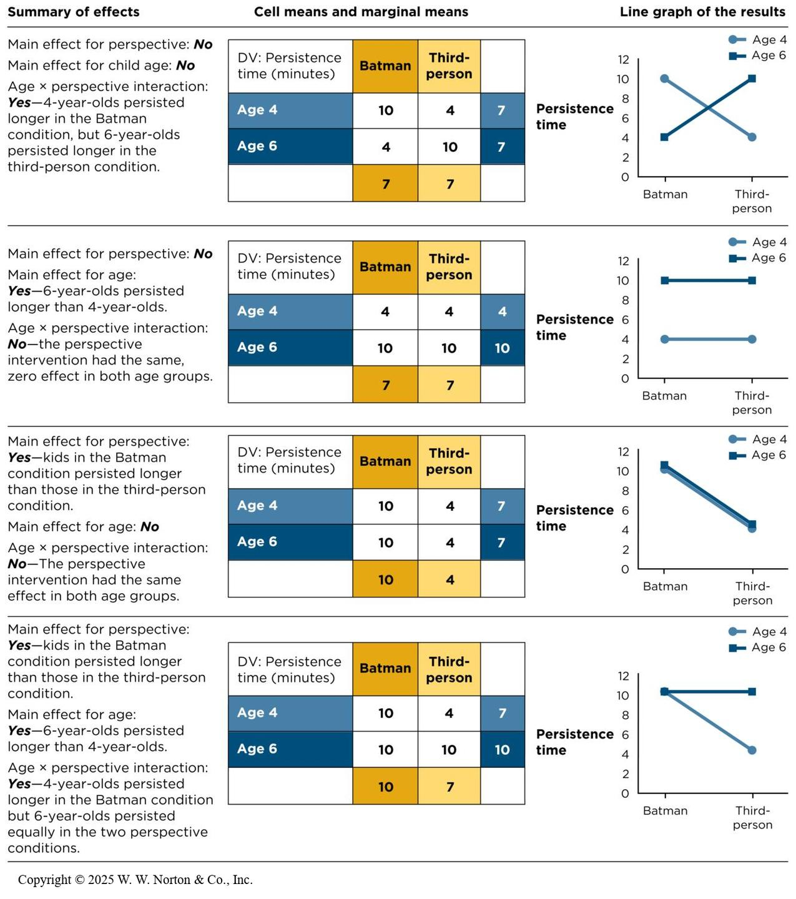
Possible Main Effects and Interactions in a 2 x 2 Factorial Design (1 of 2)
Notes:
Figure 12.18: A Range of Possible Outcomes from a Single 2 x 2 Factorial Design
Use this chart to study how various outcomes result in different patterns of main effects and interactions. (All data are fabricated for illustration purposes and error bars are omitted.)
Copyright © 2025 W. W. Norton & Co., Inc.

Slide 22
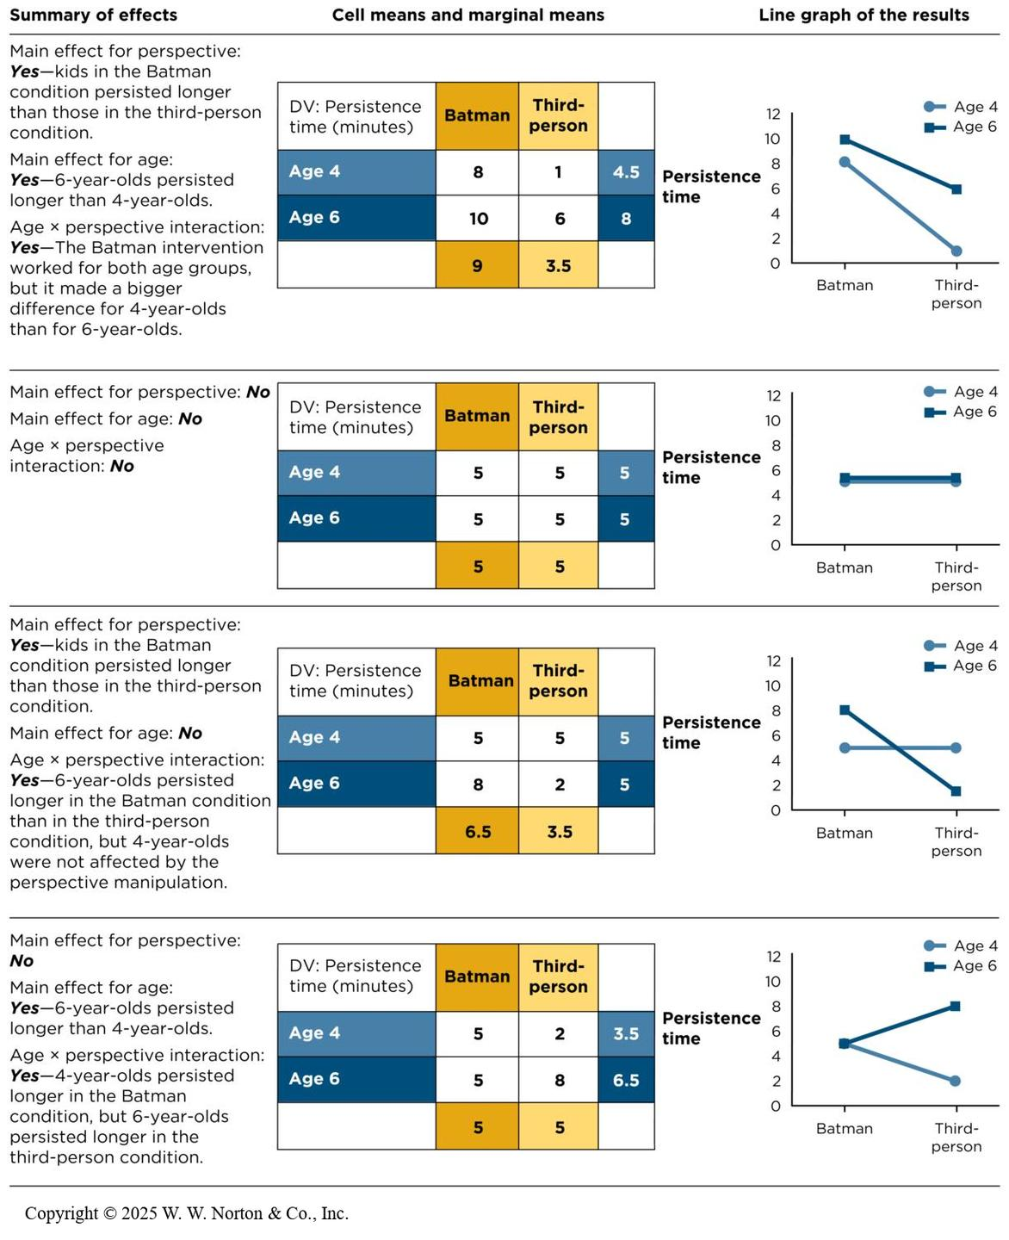
Possible Main Effects and Interactions in a 2 x 2 Factorial Design (2 of 2)
Notes:
Figure 12.18: A Range of Possible Outcomes from a Single 2 x 2 Factorial Design
Use this chart to study how various outcomes result in different patterns of main effects and interactions. (All data are fabricated for illustration purposes and error bars are omitted.)
Copyright © 2025 W. W. Norton & Co., Inc.

Slide 23
Factorial Variations
Independent-groups factorial designs
Within-groups factorial designs
Mixed factorial designs
Increasing the number of levels of an independent variable
Increasing the number of independent variables
Notes:
This section explores some advanced variations on the basic 2 x 2 factorial design such as an IV with more than two levels, an IV manipulated within groups, or addition of a third IV.

Slide 24
Independent-Groups Factorial Designs
Both IVs are studied as independent groups.
A 2 x 2 independent-groups factorial design has four groups or cells.
This is also known as a between-subjects factorial design.
Notes:
In an independent-groups factorial design (also known as between-subjects factorial), both IVs are manipulated between groups. If the design is a 2 x 2, there are four different groups of participants; for example. if you wanted 30 participants in each cell, then you would need 120 participants total (30 in each of the four groups).

Slide 25
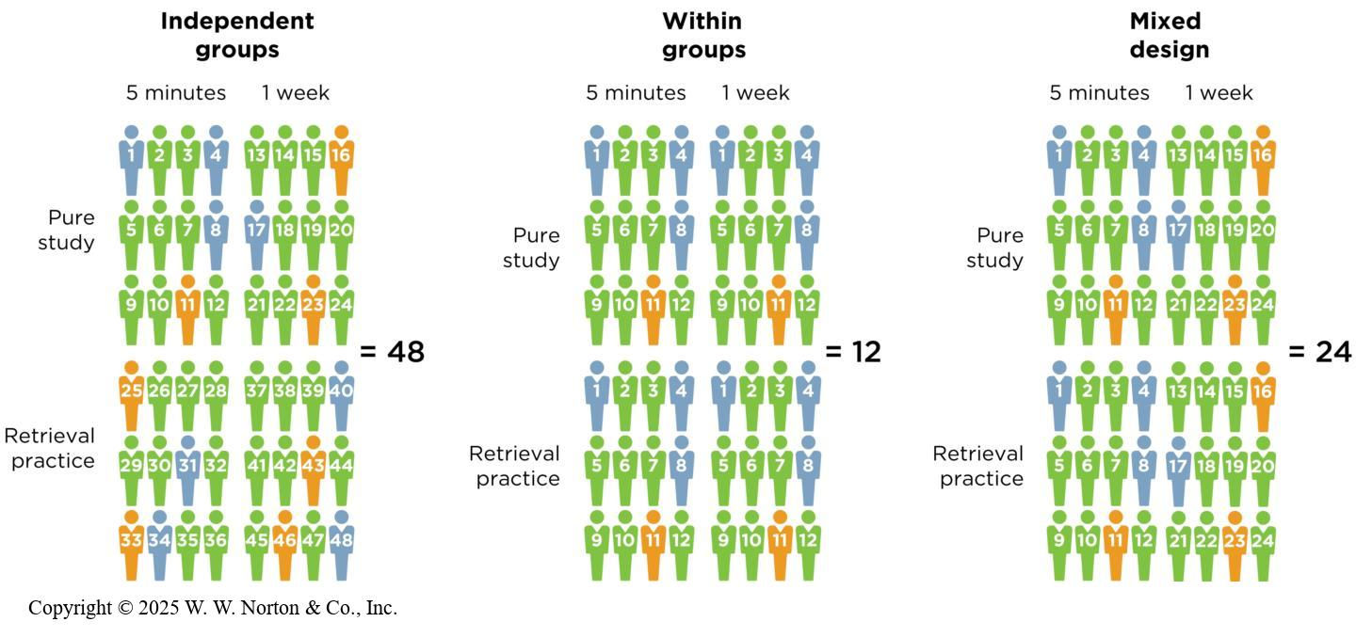
Within-Groups Factorial Designs
Notes:
Figure 12.19: Within-Groups Designs Are More Efficient
To achieve a goal of 12 observations per cell, an independent-groups factorial design would need 48 participants. A within-groups factorial design would require 12 participants, and a mixed design would require 24 participants.
In within-groups factorial designs (aka repeated-measures factorial designs), both IVs are manipulated within groups. Thus, if you have a 2 x 2 within-groups design, there is only one group of participants, but they participate in all four groups/cells; for example, if you wanted 12 participants in each cell, you would only need 12 participants total because each of those 12 people would be in each of the four conditions.
The figure shows how many participants a researcher would need to obtain 12 observations per cell in each of three types of designs. Within-groups designs are most efficient in terms of the number of participants needed.
Copyright © 2025 W. W. Norton & Co., Inc.

Slide 26
Mixed Factorial Designs
One IV is manipulated as independent-groups and the other is manipulated within-groups.
This design is intermediate between the within-groups design and the independent-groups design in terms of number of participants.
Notes:
Mixed factorial designs are a combination of independent-groups designs and within-groups designs. One IV is manipulated as independent groups and the other IV is manipulated within groups. In a 2 x 2 mixed factorial design with 50 people in each cell, you would need 100 participants, which is twice as many participants as a within-groups design and half as many as an independent-groups design.

Slide 27
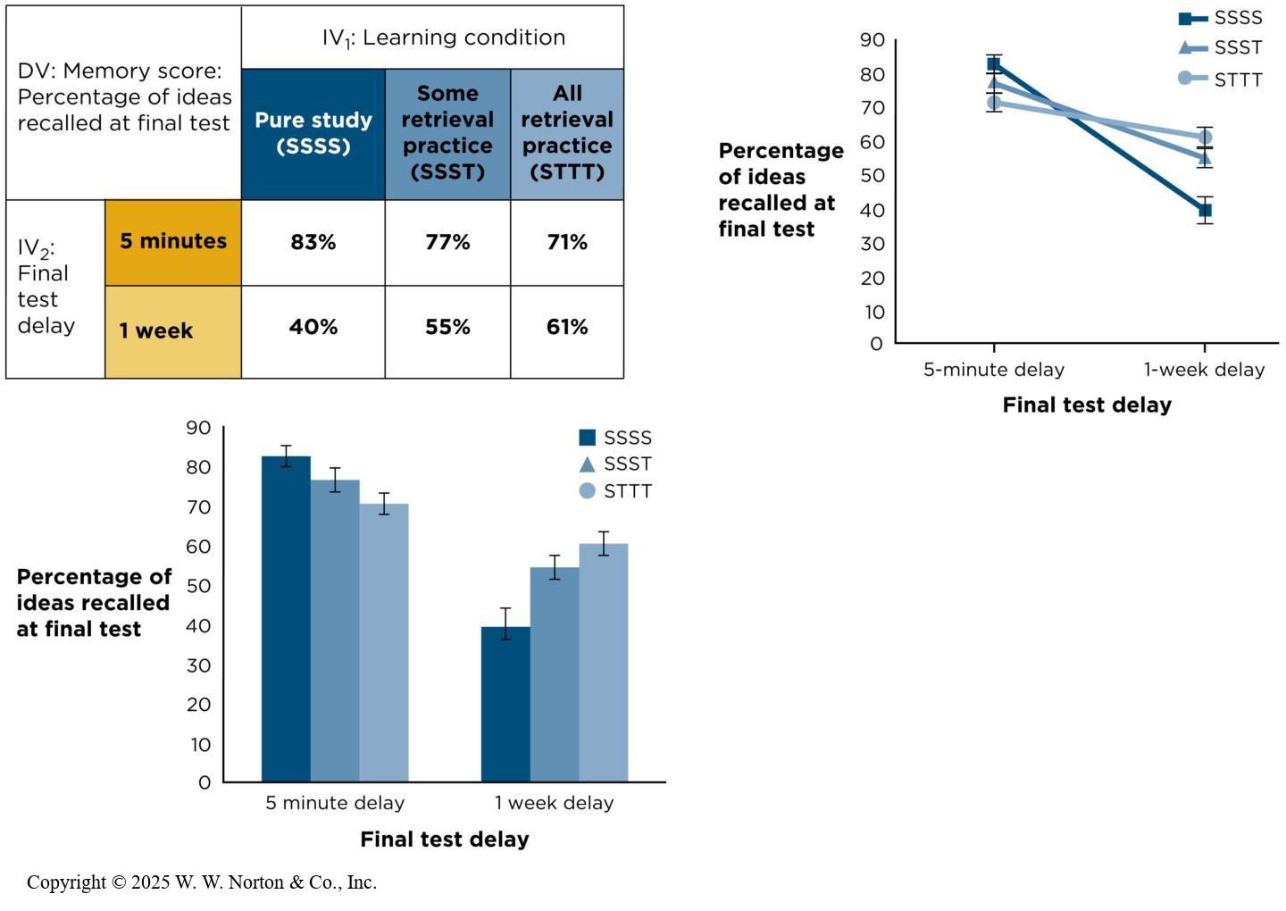
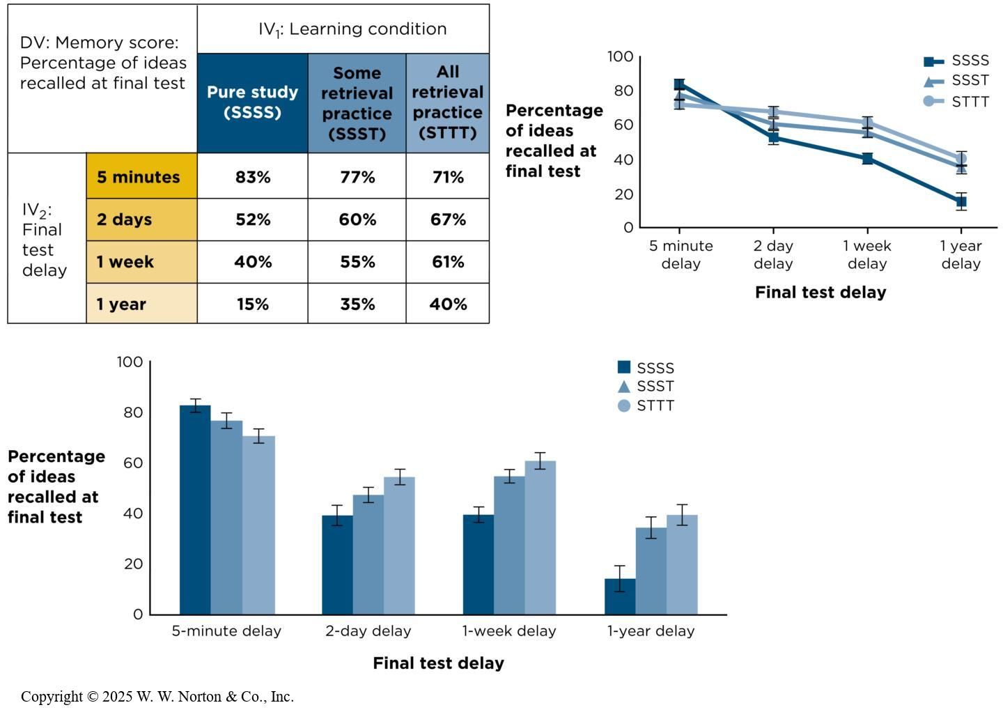
Increasing the Number of Levels of an Independent Variable
Notes:
Figure 12.20: A 2 x 3 Factorial Design
The original study was a 2 × 3 design. It can be graphed as a line graph or bar graph. Error bars indicate standard errors. (Source: Adapted from Roediger & Karpicke, 2006.)
Copyright © 2025 W. W. Norton & Co., Inc.
Figure 12.21: A 3 x 4 Factorial Design
(Here 2-day and 1-year data are fabricated for illustration purposes.)
Researchers can add more levels to their IVs. Suppose a retrieval practice study decided to turn its 2 x 2 factorial design into a 2 x 3 factorial design by adding a third level to the prime type IV (related prime, unrelated prime, no prime). This would change the number of cells from 4 (2 x 2) to 6 (2 x 3). This is depicted in the top figure.
Factorials are notated like this: ___ x ___. The number of blanks tells you the number of IVs, and the numbers that you put in the blanks tell you the number of levels of each IV.
Suppose the number of levels on the recall task variable increased from 2 to 4. Now it is a 3 (prime type) x 4 (recall task) factorial design. See the bottom figure. There are 12 cells (3 x 4), making it a 3 x 4 factorial design.
Main effects can still be calculated by using marginal means and seeing whether they are different. Interactions are most easily detected with a line graph to see whether the lines are parallel. In both cases, statistical tests would need to be performed to determine if the main effects and interactions are statistically significant.
Copyright © 2025 W. W. Norton & Co., Inc.

Slide 28
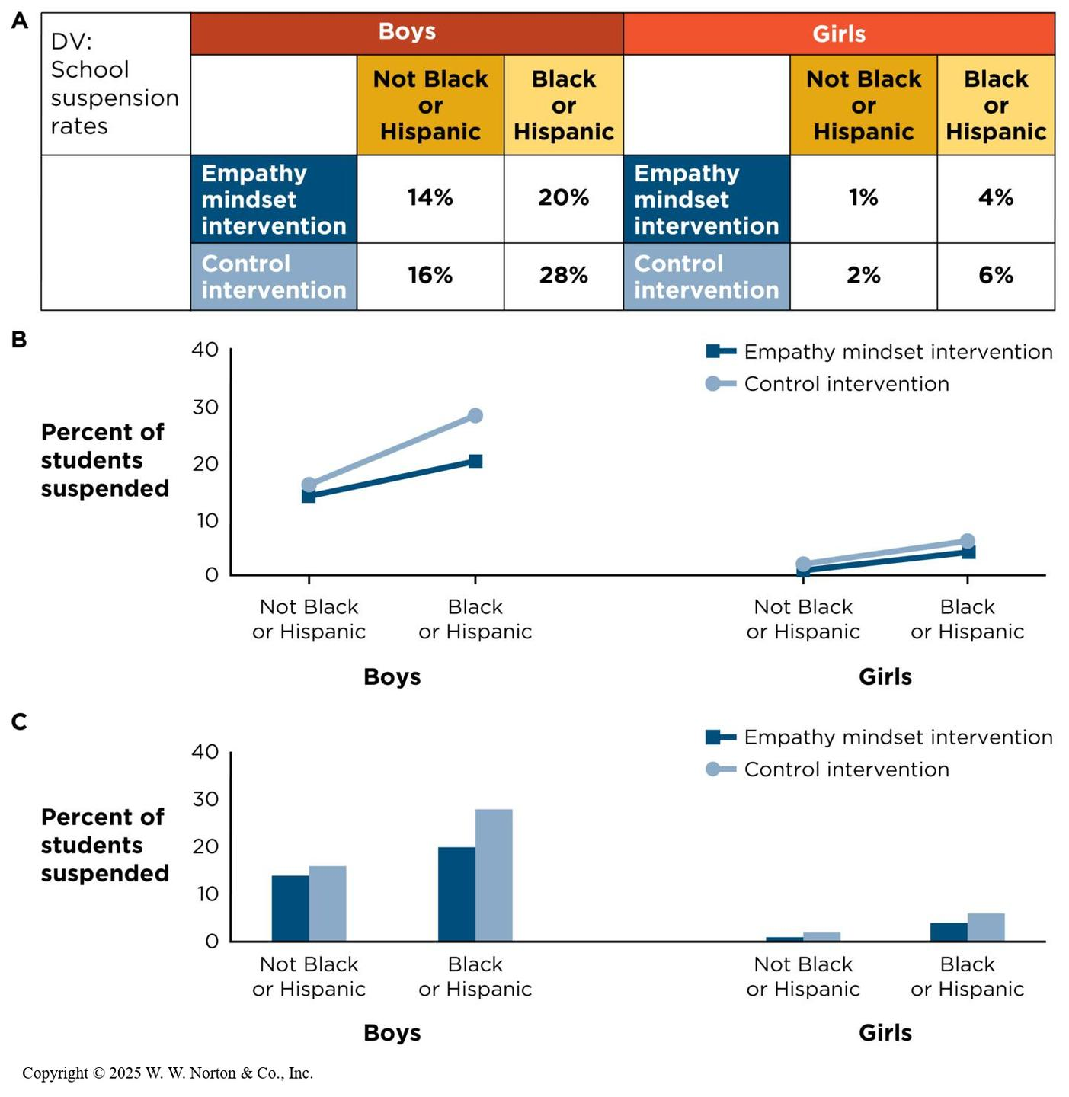
Increasing the Number of Independent Variables
Main effects and interactions from a three-way design
Why worry about all these interactions?
Notes:
Figure 12.22: A 2 x 2 x 2 Factorial Design
(A) Two side-by-side tables. (B) Two sideby-side line graphs. (C) Two side-by-side bar graphs. The studies by Okonofua and colleagues (2016, 2022) reported no three-way interaction with gender. (Data are fabricated for illustration purposes and error bars are omitted.)
Sometimes, more than two independent variables (IVs) are needed. For example, suppose researchers in Okonofua’s study on the effect of teacher empathy decided to add a third IV of student behavior type with two levels: disruptive behavior and compliant behavior. Now we have a 2 (student grade level) x 2 (teacher empathy training) x 2 (student behavior type) factorial design. This is also called a three-way design because there are three IVs. This means there would be eight cells (2 x 2 x 2).
If you look at the table, the best way to represent a three-way design is to create the 2 x 2 table twice (once for each level of the third IV, student behavior type). To graph the three-way design, you would do the same thing by having two graphs side by side—one for disruptive behavior and one for compliant behavior.
Copyright © 2025 W. W. Norton & Co., Inc.

Slide 29
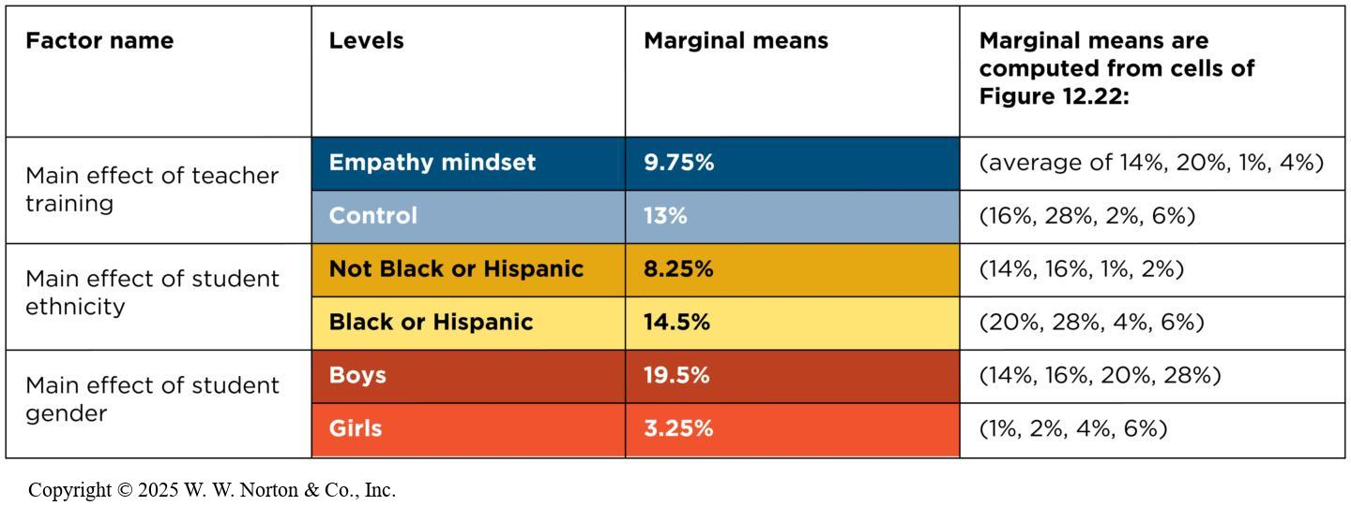
Main Effects and Interactions from a Three-Way Design
Main effects: Is there a difference?
Notes:
Figure 12.23: Main Effects in a Three-Way Factorial Design
When there are three independent variables (IVs) (as in a 2 x 2 x 2 factorial design), there will be three main effects to test. Remember that main effects are simple overall differences that examine the effect of one IV averaged across the other two IVs.
The table examines three main effects within the study on the effect of teacher empathy: teacher empathy training, student grade level, and student behavior type. Students taught by empathy-trained teachers showed higher engagement than those taught by non-trained teachers, high school students were more engaged than elementary school students, and compliant students were more engaged than disruptive students. Thus, there are main effects for teacher empathy training, student grade level, and student behavior type.
Copyright © 2025 W. W. Norton & Co., Inc.

Slide 30
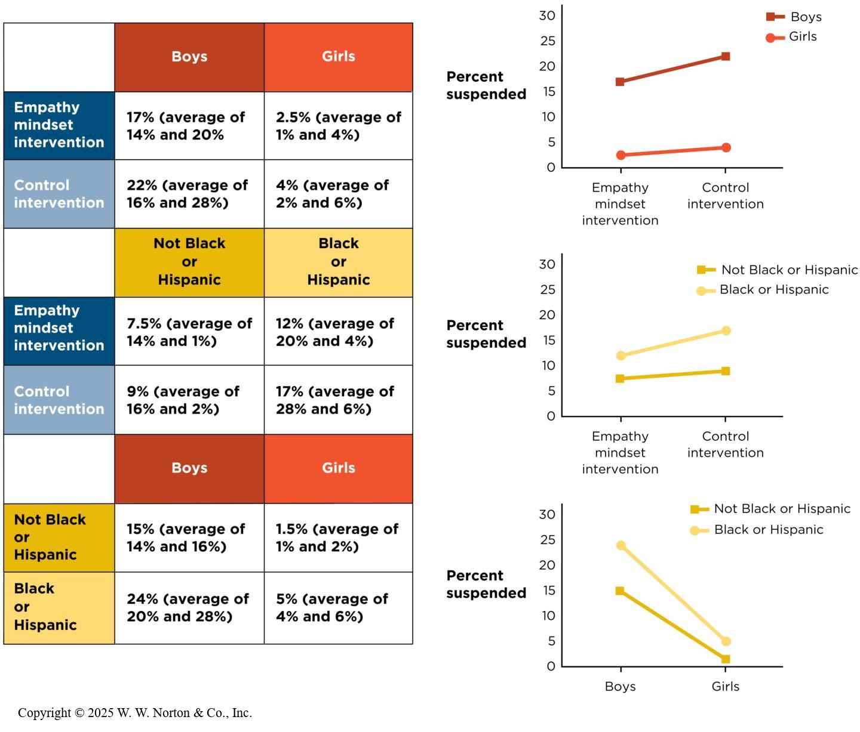
Main Effects and Interactions from a Three-Way Design: Two-Way Interaction
Two-way interactions: Is there a difference in differences?
Notes:
Figure 12.24: Two-Way Interactions in a 2 x 2 x 2 Factorial Design
Data are recombined to estimate the three two-way interactions in this study. The means come from Figure 12.22. (Data are fabricated for illustration purposes, equal Ns are assumed, and error bars are omitted.)
In a three-way design, there are three possible two-way interactions: student grade level x student behavior type, student grade level x teacher empathy training, and teacher empathy training x student behavior type. To examine each of these two-way interactions, you create three 2 x 2 tables (see Figure 12.24). After computing the means, you can look at the difference in differences. However, it’s probably easier to graph the interaction and look for nonparallel lines. This should be followed up by statistical tests to determine statistical significance.
Copyright © 2025 W. W. Norton & Co., Inc.

Slide 31
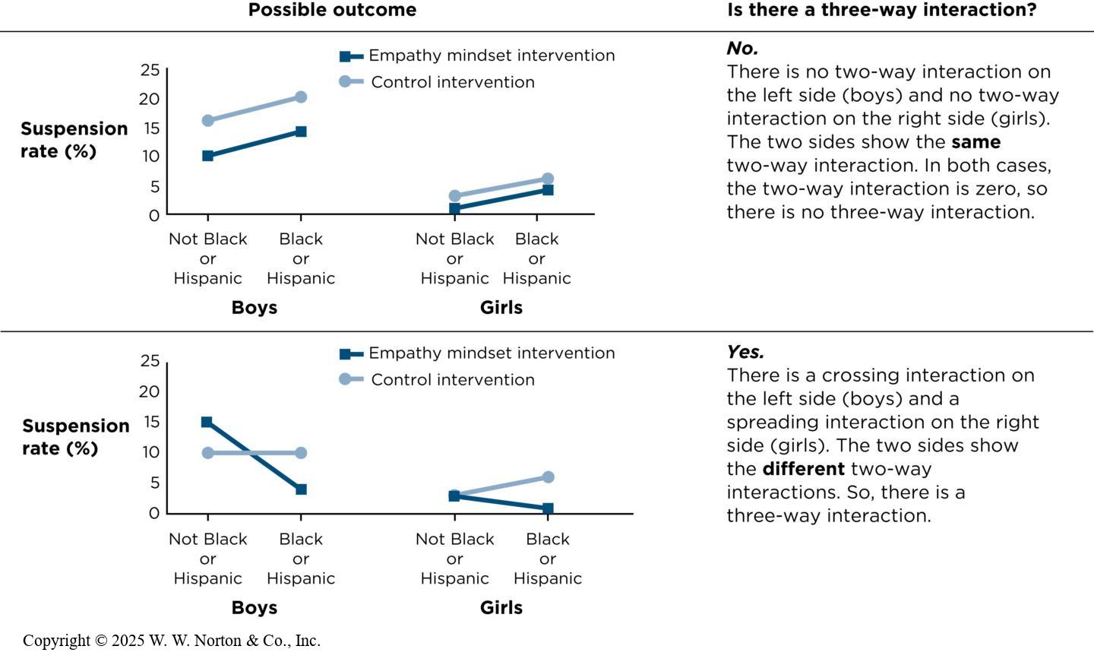
Main Effects and Interactions from a Three-Way Design: Three-Way Interaction (1 of 2)
Three-way interactions: Are the two-way interactions different?
Notes:
Figure 12.25: Three-Way Interactions in a 2 x 2 x 2 Factorial Design
If there is a three-way interaction, it means the two-way interactions are different, depending on the level of a third independent variable. This table shows different possible patterns of data in a 2 × 2 × 2 design. (All data are fabricated for illustration purposes and error bars are omitted.)
In the study on genders in leadership roles, the three-way interaction is gender of leader (2) x leadership style (2) x team dynamics (2). If the three-way interaction is significant, it means that the two-way interaction between two of the IVs depends on the level of the third IV. In other words, the difference in differences is different.
It’s easiest to examine three-way interactions using line graphs. In the top graph, there is no three-way interaction because there’s no two-way interaction on the left and no two-way interaction on the right. In the bottom graph, there is a three-way interaction because there is a crossing interaction on the left and a spreading interaction on the right. The two sides show different two-way interactions, indicating a three-way interaction.
Copyright © 2025 W. W. Norton & Co., Inc.

Slide 32
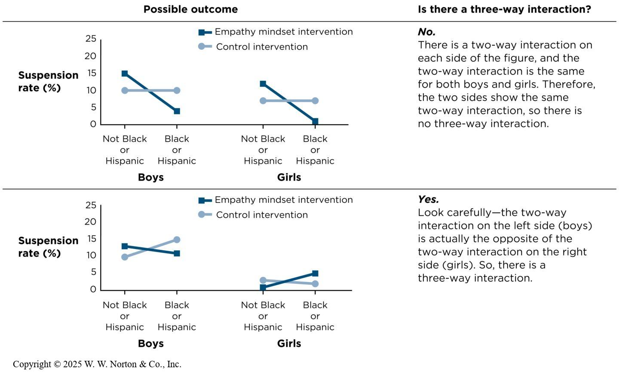
Main Effects and Interactions from a Three-Way Design: Three-Way Interaction (2 of 2)
Three-way interactions: Are the two-way interactions different?
Notes:
Figure 12.25: Three-Way Interactions in a 2 x 2 x 2 Factorial Design
If there is a three-way interaction, it means the two-way interactions are different, depending on the level of a third independent variable. This table shows different possible patterns of data in a 2 × 2 × 2 design. (All data are fabricated for illustration purposes and error bars are omitted.)
In the study on genders in leadership roles, the three-way interaction is gender of leader (2) x leadership style (2) x team dynamics (2). If the three-way interaction is significant, it means that the two-way interaction between two of the IVs depends on the level of the third IV. In other words, the difference in differences is different.
It’s easiest to examine three-way interactions using line graphs. In the top graph, there is no three-way interaction because there’s no two-way interaction on the left and no two-way interaction on the right. In the bottom graph, there is a three-way interaction because there is a crossing interaction on the left and a spreading interaction on the right. The two sides show different two-way interactions, indicating a three-way interaction.
Copyright © 2025 W. W. Norton & Co., Inc.

Slide 33
Why Test All These Interactions?
Most outcomes in psychological studies are not main effects, but rather interactions.

Slide 34
Identifying Factorial Designs in Your Reading
Identifying factorial designs in empirical journal articles
Identifying factorial designs in popular press articles
Notes:
There are certain clues that will let you recognize a factorial design when you are reading a scholarly journal article or a popular press article.

Slide 35
Identifying Factorial Designs in Empirical Journal Articles
The Method section will describe the design of the study.
    Factorial notation: _____ x _____ x _____
The Results section will examine whether the main effects and interactions were significant.
    Reference to “significance” or a p value and information about MANOVA and F
Notes:
In the Method section of a scholarly journal article, you will find information about the design of the study. One clue that you’re reading about a factorial design is that you’ll see mention of a 4 x 2 design, a 3 x 2 x 3 design, and so forth. This tells you the number of IVs in the study and the number of levels in each IV.
You might read the word “significant” or see the notation p < .05 to let you know that a main effect or interaction is significant. You might also read about a MANOVA or F test being conducted to examine main effects and interactions.

Slide 36

Identifying Factorial Designs in Popular Media Articles
Look for phrases such as “it depends” or “only when” used to highlight an interaction.
Look for participant variables (e.g., age, gender, ethnicity).
Notes:
Figure 12.26: Dogs as Subjects in a Factorial Design
According to a study covered in the popular media, researchers learned that, like the human brain, a dog’s brain processes both the emotional tone and the lexical content of speech.
Popular press articles usually don’t specify what kind of design was used because journalists are trying to make the research simpler so it can be understood by the general public. Thus, there are different clues to look for when reading a popular press article.
One such clue is looking for the phrases “it depends” or “only when” to describe an interaction; for example, driving ability while talking on a cell phone depended on the age of the driver.
Another such clue is looking for participant variables such as age, gender, or ethnicity. The participant variable might moderate another IV, and when there’s a moderator then there’s an interaction, and a factorial design; for example, older adults took longer to brake when talking on a cell phone, whereas younger adults did not show a decrease in driving ability.
Eniko Kubinyi

